Slide 1
Chesterfield – Allied
230 kV Transmission Line Rebuild Project
Fall 2020
1

Slide 2
Agenda
Project Area
Need for Rebuild
Scope of Project
Community Engagement

Slide 3
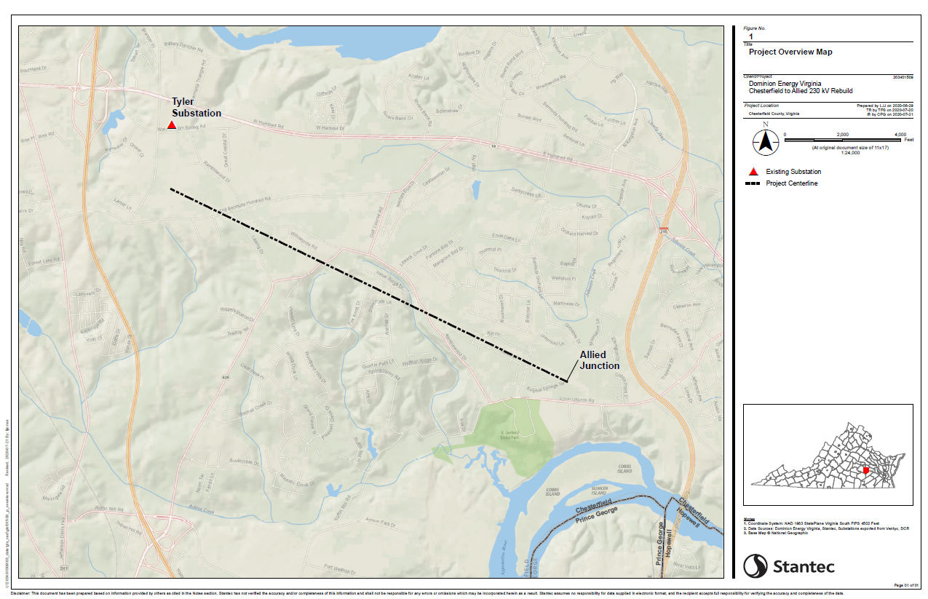

Slide 4
Reliability Concerns & Drivers
Approximately 2.7 miles of 230 kV transmission line between Chesterfield – Allied Substations at the end of service life.
Structures were originally installed in 1967
COR-TEN® weathering steel towers have experienced issues across Dominion Energy’s system when used for lattice-type structures
Structures to be rebuilt to current safety and reliability standards

Slide 5
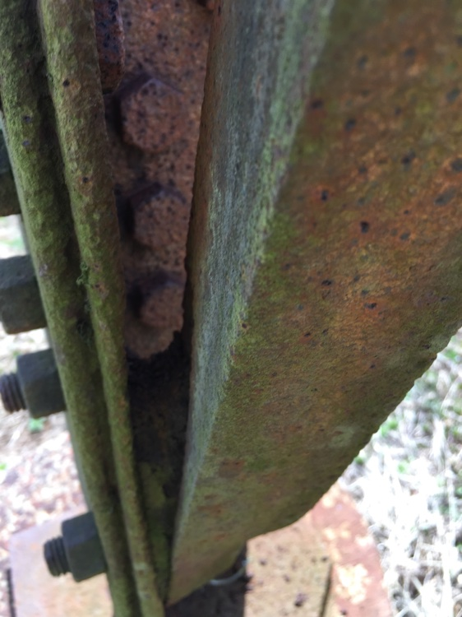
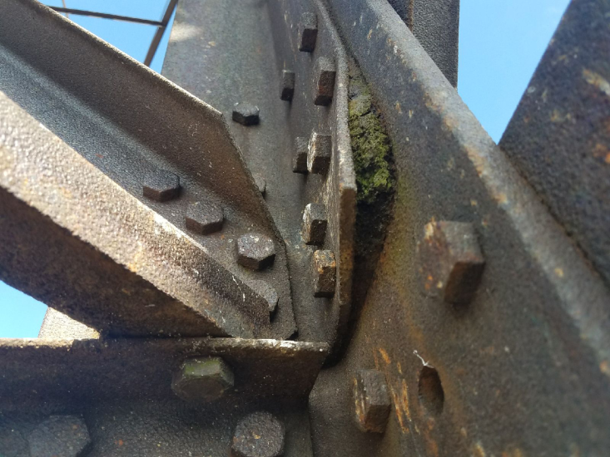
Representative Pictures of Aging Structures

Slide 6
Proposed Solution
In order to maintain structural integrity and reliability, Dominion Energy is proposing to rebuild 16 structures along the existing transmission corridor.
Located entirely within existing right of way
Replacement of lattice structures with monopole structures
Proposed weathering steel to match replaced and remaining poles
Partial co-location with another transmission line
Target completion date: April 2022

Slide 7
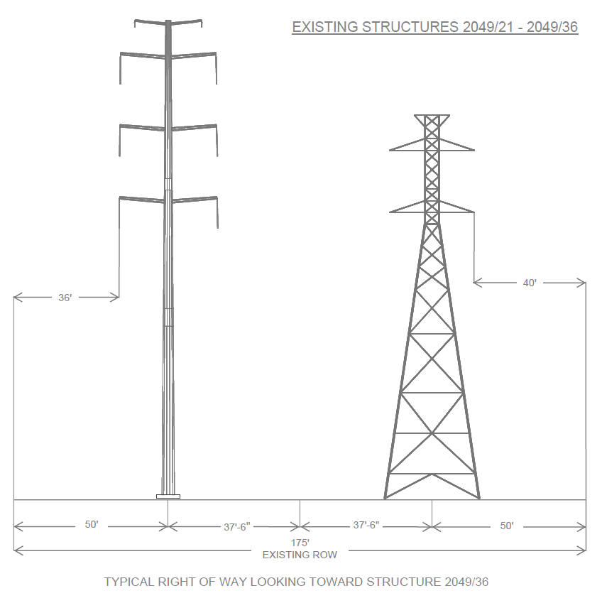
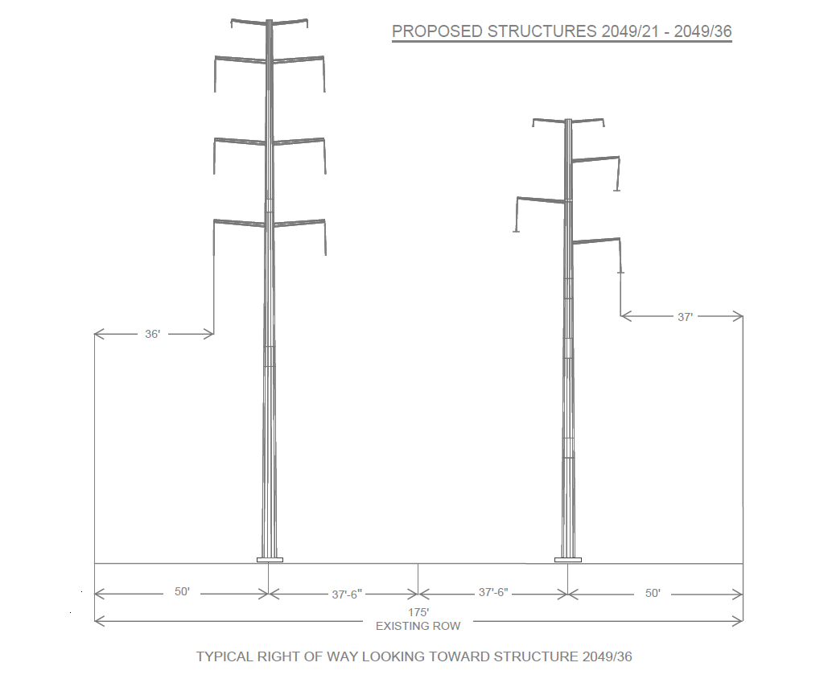
Existing vs. Proposed Structures
*Average 1.5’ height increase

Slide 8
Public Safety & Access
Encroachments
  Primarily unauthorized sheds
  Dominion Energy will take customary approach to fences in right of way
Engagement Plan
  Grassroots education on encroachments
  Limited funds for removal/relocation of non-conforming encroachments
Danger Tree Clearing

Slide 9
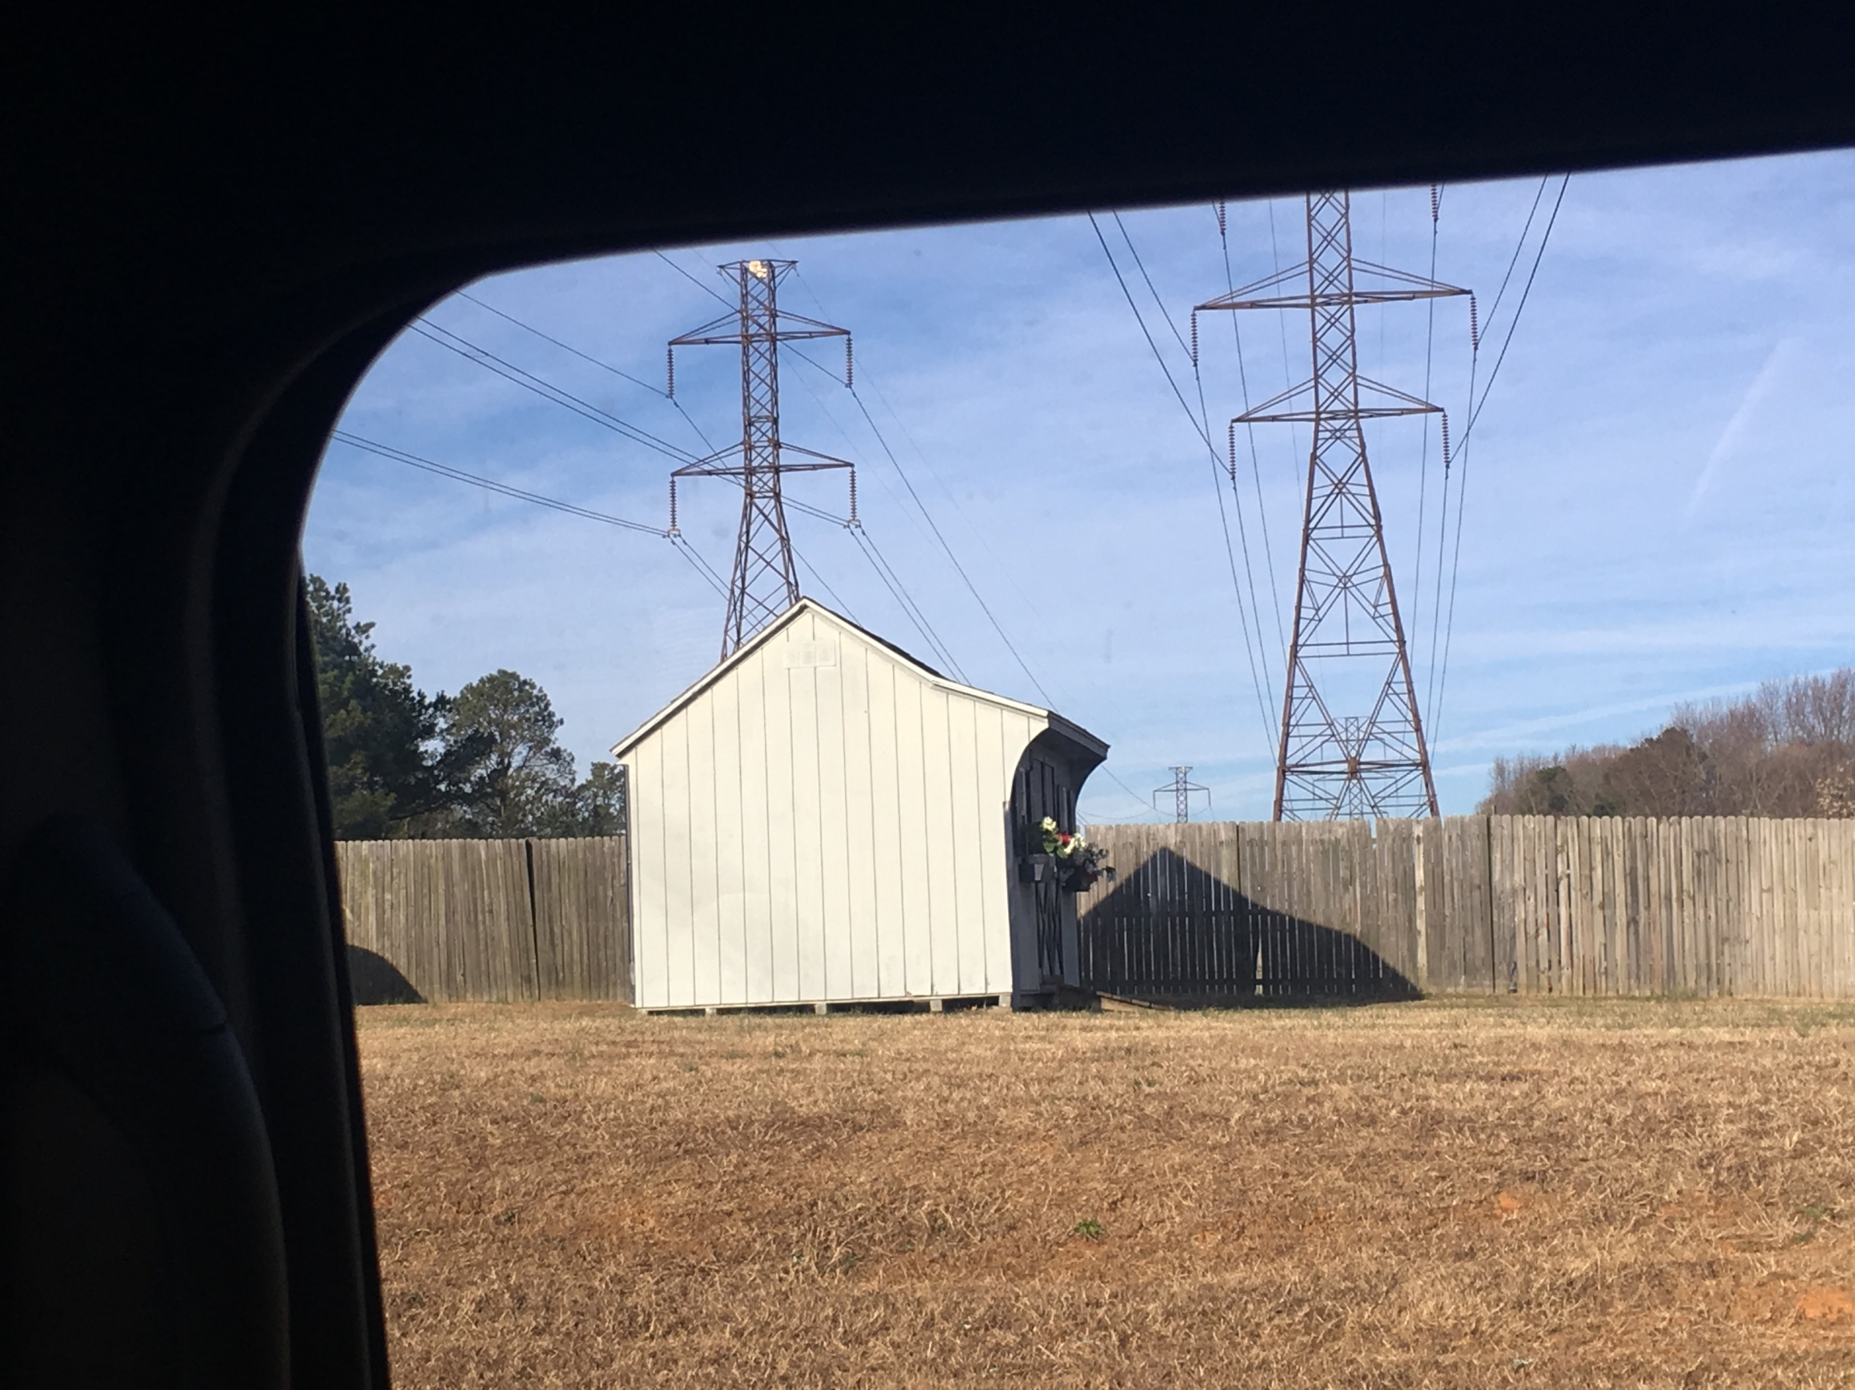

Slide 10
Next Steps
Summer 2020
Meet with local elected officials
Sept. 22, 2020
Host two virtual community meetings
File Application with Virginia State Corporation Commission (SCC)
Fall 2020
TBD
Spring 2021
Procedural Order Issued, Public Hearing Scheduled
Requested date for SCC approval
April 2022
Projected In-Service Date
Launch project website; Dedicated email/phone open

Slide 11
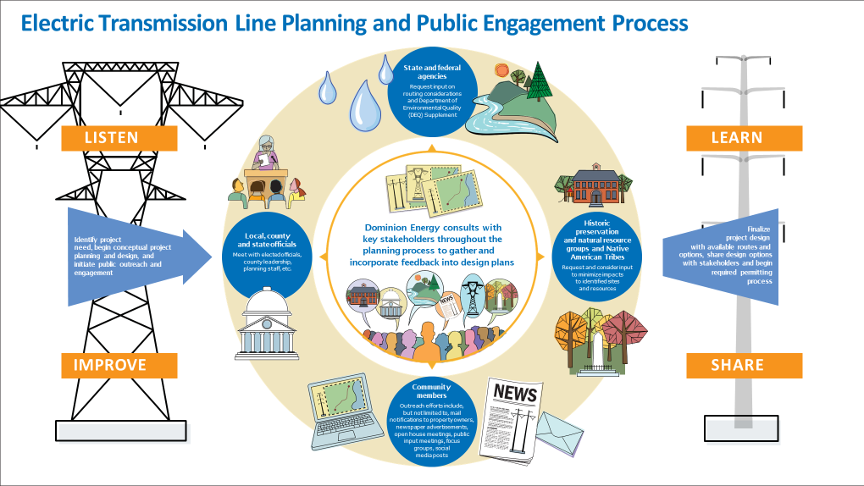

Slide 12
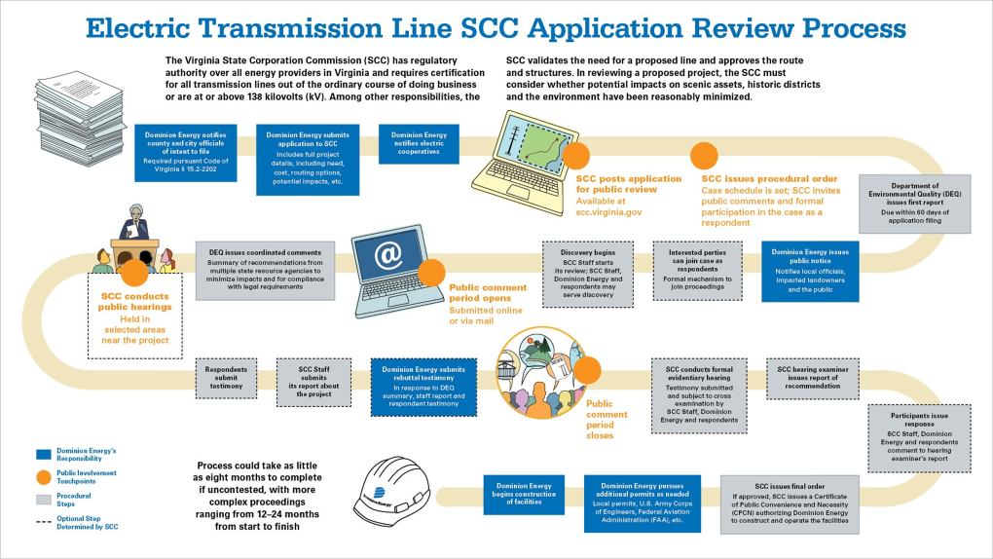

Slide 13
Questions
Dedicated Project Page: DominionEnergy.com/chesterfieldallied
888-291-0190
powerline@dominionenergy.com

